Slide 1


Uganda!
Kampala Traffic Congestion Management Plan 2014-2019 Slide show

Slide 2
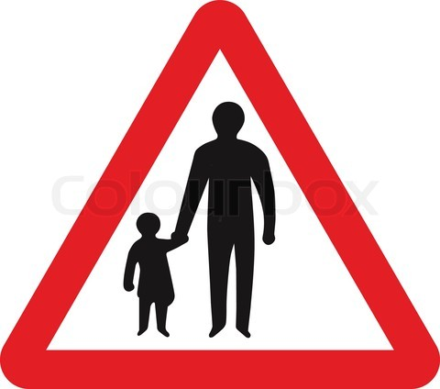
ROAD SAFETY INITIATIVE UGANDA
rsi
Plot 681 Gayaza Road; P. o. Box 36293; Kampala [Uganda];
Website: rsiug.webs.com
E-mail: roadsafety16@gmail.com
Tel. +256759888093; 0772888093;
^{Generation of new ideas}

Slide 3
About us
Road Safety Initiative (Uganda) RSI is a Non-Government Organisation dedicated to:
Inform and to educate the public on Road Safety and; Urban Traffic Congestion management (how to safely utilise full capacity of roads).
Inform and educate the public about the new case study-style of increasing traffic and new road designs in the first world. (RSI/obj./m)
RSI (U) has written more than 17 Training Manuals on Safety and Health; a list of which is found on our website where free copies can be downloaded including “Questions and Answers to HIV/Aids & Tuberculosis” and;
  PUBLIC SAFETY AND SECURITY AWARENESS - CRIME WATCH
RSI was found in 2010 by Mr. Muteza and friends after his training in Great Britain (London) in Road Safety and Urban Traffic Congestion Management.
We recognise that we do not work alone. There is a team of experts and partners that contribute to the success of our activities.

Slide 4
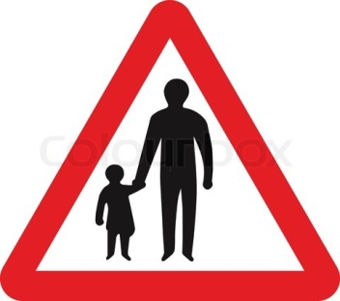
Kampala City
Traffic Congestion Management Plan
2014-2019
^{Generation of new ideas}
Presented by: Road Safety Initiative (U) to KCCA
(Kampala City Council Authority)
03rd.Nov.2014

Slide 5
Introduction
Traffic Congestion, Gridlock or Traffic jam:
Traffic congestion is demand for road space outstripping the available road infrastructure to the extent that free movement of traffic is nearly impossible or;
The situation where travel demand exceeds the capacity of the transportation network.
Measuring Traffic Congestion:
Traffic congestion is the extra-time taken compared to the time taken on the same journey in uncongested conditions or free flow.
Traffic Congestion in Kampala:
The economy of Ugandan is growing, the population increasing and the road network is expanding. However, it is practically impossible to build enough road-infrastructure to comfortably accommodate the exceeding demand for travel without managing congestion.
Kampala city is extremely congested; disorderly with traffic and this problem is growing day by day.

Slide 6
DANGERS OF
TRAFFIC CONGESTION
Traffic Congestion has direct economic and social costs which in turn impose heavy costs on the National economy.
These costs can damage the competitiveness of Kampala in the regional market and the attractiveness of the city as both a tourist destination and a place to live; such costs are:
Reduced productive time,
Loss of investments and jobs;
Fuel waste;
Increased risks and costs to motorists and pedestrians;
Green House Gas emissions (GHGE) polluting the air quality;
Diseases to urban inhabitants by breathing in exhaust fumes;
Unpredictable journey times, queuing, slower speeds and increased travel times;
Stress/anger /Tiredness as a result of road rage (Violence exhibited by drivers in traffic jam) etc.

Slide 7
Need to Manage
Traffic Congestion in Kampala
Tackling traffic congestion is smoothing the traffic flow, goods and services; as well as reducing the risk of accidents.
The emphasis is not to increase the speed of traffic but to ensure journeys run more smoothly and that the driver or passenger can more reliably estimate the time the journey takes.
We do recognise that there are no easy solutions.
However through our experience in Road Safety activities, we have carefully refined ways compatible to the Ugandan situation; designed to remarkably streamline the traffic flow using the existing road infrastructure in Kampala, in accordance with the existing policies.

Slide 8
MAIN FACTORS INFLUENCING TRAFFIC
CONGESTION IN KAMPALA
Competitive Driving at road junctions
Traffic congestion in Kampala mainly originate at road-junctions and roundabouts which in turn extend to the corresponding roads and lanes.
This is due to competitive driving as taxis, couriers, delivery trucks, Buses, private vehicles, Boda-bodas and pedestrians all competing for the available road-space in order to manoeuvre.
2. Wrong parking & Pavement Activities
Parking at road junctions by vehicles and Boda-boda stages, along arterial roads, double parking, parking cross-ward roads instead of parking alongside the kerb.
Pavement activities that deny pedestrians the walk space thereby sending them into the flowing traffic adding congestion on roads.
3. Under use of roads
Limiting the use of FOUR lane-capacity roads to only TWO at peak hours of traffic.
The full capacity of the Road-lanes should be used especially at peak hours of traffic to reduce queues (length of lines).
4. Traffic lights that do not coordinate with the volume of traffic from a particular direction but equal intervals.

Slide 9
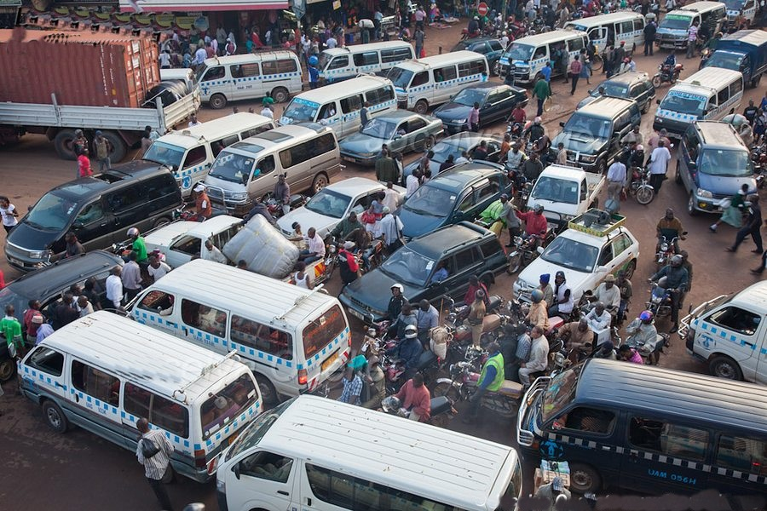
Images of Competitive Driving at Road Junctions
Competitive Driving at road junctions is the main cause of traffic congestion in Kampala

Slide 10
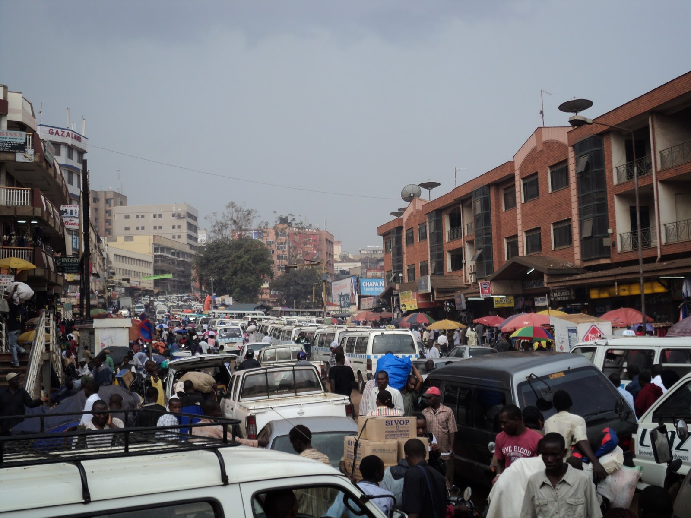
NO waiting
sign
loading
Competitive Driving at road junctions is the main cause of traffic congestion in Kampala

Slide 11
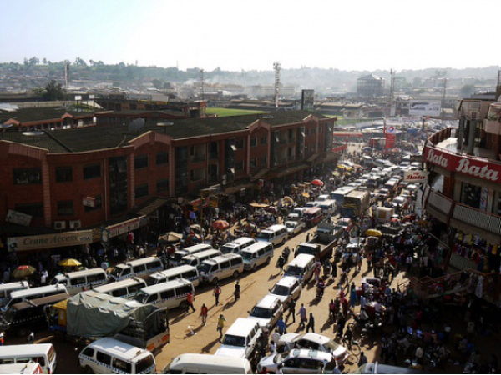
Competitive Driving at road junctions is the main cause of traffic congestion in Kampala

Slide 12
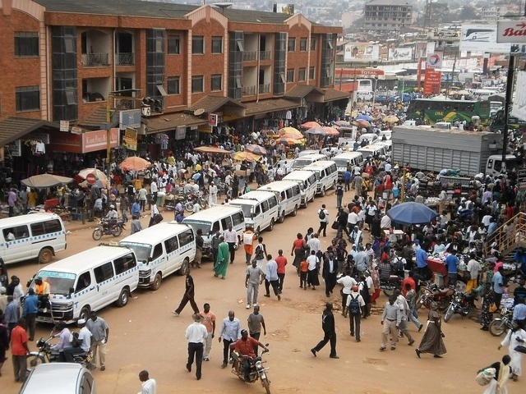
The traffic guide is NOT conversant with traffic rules. The lorry has failed to turn because of pavement activities bringing the junction to a standstill.
Competitive Driving at road junctions is the main cause of traffic congestion in Kampala

Slide 13
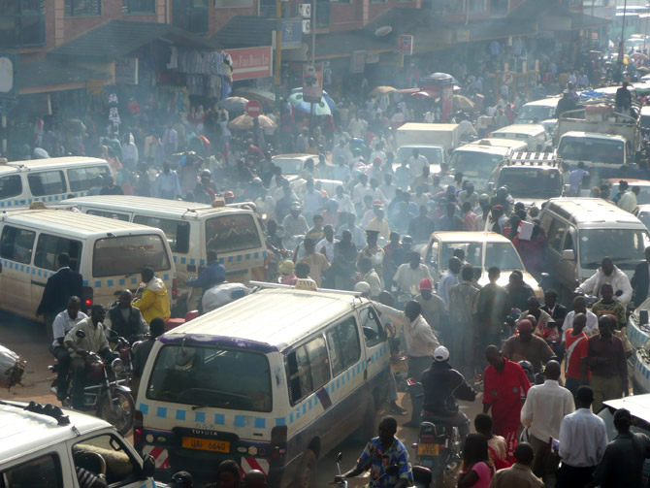
Competitive Driving at road junctions is the main cause of traffic congestion in Kampala

Slide 14
SOLUTION
TO
Competitive Driving and
TRAFFIC CONGESTION
AT
ROAD-JUNCTIONS

Slide 15
Why drivers compete at road junctions:
Drivers compete at road junctions because the road-junctions in Kampala are NOT marked with “on road surface priority restriction markings” .
Preventing “Competitive Driving” at Road Junctions is preventing Traffic Congestion that extends to the corresponding roads and lanes.
How to prevent Competitive driving and traffic congestion at Road Junctions:
The intersection areas of the road-junction-surface is marked with “On-road surface restriction markings” known as:
The "Junction Box",
“Keep Clear” or
“Priority” restriction-road-Markings.
A Junction-Box is a road traffic control measure designed to prevent traffic congestion and gridlocks at road junctions, large roundabouts and railway crossings.
A Junction Box is marked on the road surface regardless of traffic lights in place.
It instils road discipline in motorists to obey the Highway Code for fear of fines; thereby preventing traffic jam.

Slide 16
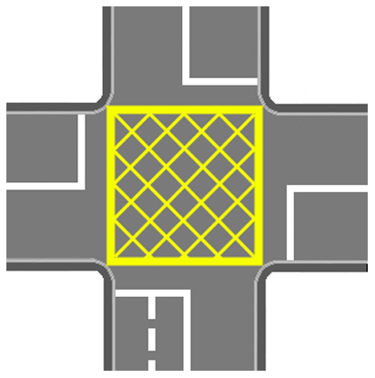
THE
JUNCTION-BOX
A Junction-Box has criss-cross yellow lines painted on the road-surface; they are cheap to mark but extremely effective in preventing traffic jam and gridlocks.

Slide 17
Why the Junction Box is such a Powerful Tool
Because of the three cardinal rules:
You MUST KEEP to the correct lane as you enter a junction-box;
You MUST NOT enter the Junction-Box unless your exit road, lane or railway crossing is clear;
YOU MUST NOT STOP IN THE BOX unless waiting to turn right when your exit road or lane is clear.

Slide 18
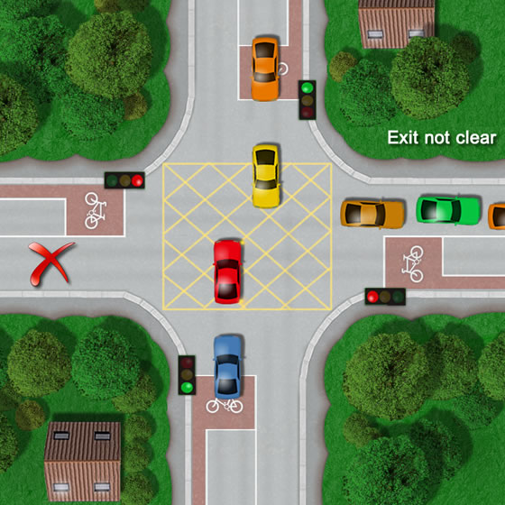
A JUNCTION BOX AT CROSS-ROADS
The exit route of the car turning right is NOT CLEAR.
When the traffic lights change this driver is likely to cause a gridlock to traffic from:
His right flowing strait ahead and Traffic from his right turning right.

Slide 19
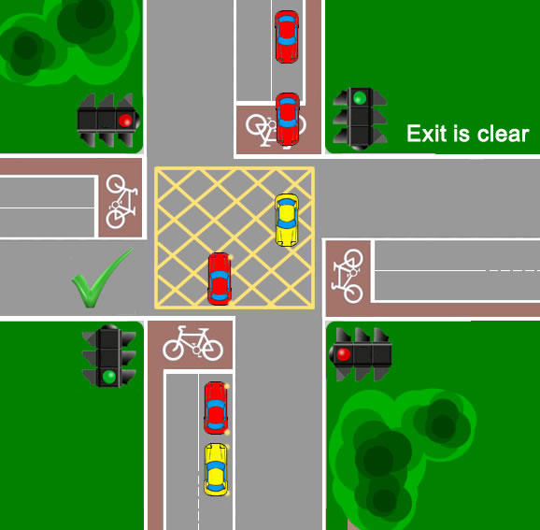
The exit route of the car turning right IS CLEAR.
He is waiting in the junction Box to turn right because his exit lane is clear!

Slide 20
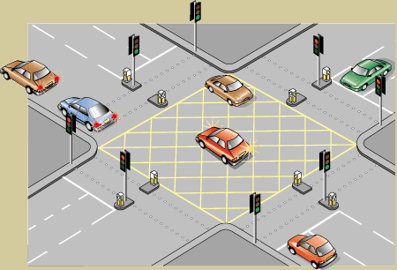
EXIT NOT CLEAR BUT TRAFFIC LIGHTS INDICATING GREEN
EXAMPLE: CITY SQUARE; JUNCTION – Kampala
EVEN WHEN the traffic lights indicate GREEN You MUST NOT enter the junction box unless your exit route is clear.
This driver cannot proceed because his exit route ahead is NOT clear.
The driver turning right is waiting in the junction box because his exit lane is clear but is being prevented by an on coming traffic.

Slide 21
JUNCTION BOX
AT
DUAL CARRIAGEWAYS

Slide 22
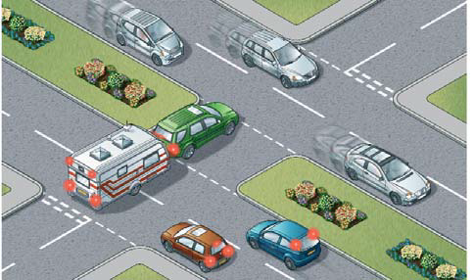

Dual Carriage without a Junction Box
Central Reservation NOT CLEAR
This ONE driver could be obstructing the flow of hundreds of traffic from his right.

Slide 23
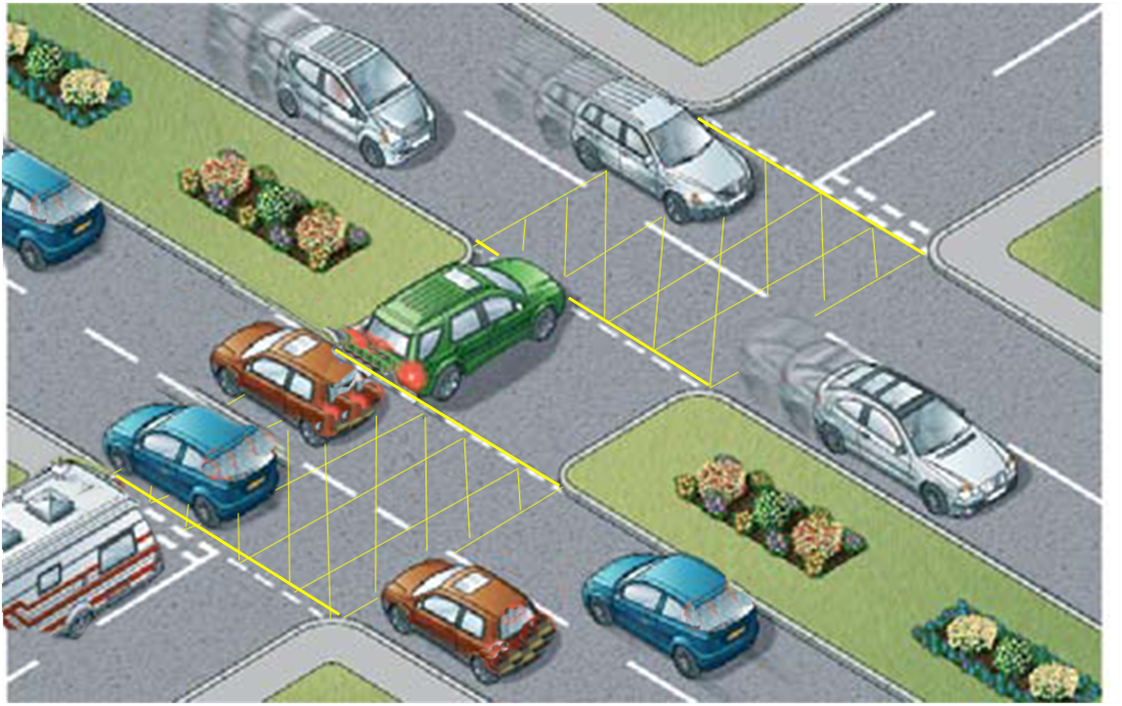

Dual Carriage with a Junction Box
Central Reservation NOT CLEAR
You MUST NOT enter the Junction Box unless your exit road or lane is clear!
To allow smooth flow of traffic

Slide 24
JUNCTION BOX
AT
SIDE-ROADS
A minor road branching off a main road

Slide 25
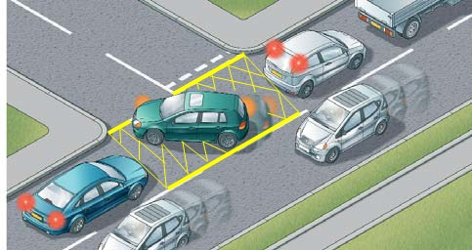
Sideroad with a Junction Box
This driver could NOT enter the Junction Box because his exit is NOT clear. This allows traffic flow to the side-road to proceed and the traffic moving straight ahead.
YOU MUST NOT ENTER THE JUNCTION BOX UNLESS YOUR EXIT ROAD OR LANE IS CLEAR

Slide 26
Junction-box at Large
Roundabouts
Rule of the roundabout:
Follow the correct lane at roundabouts and; give way to traffic coming from your right.
REMEMBER: Long vehicles need more space to manoeuvre.

Slide 27
Example Northern Bypass – Kalerwe – roundabout Kla.
Follow the correct lane at roundabouts and give way to traffic coming from your right.
REMEMBER: LONG VEHICLES NEED MORE SPACE TO MANUVOUR

Slide 28
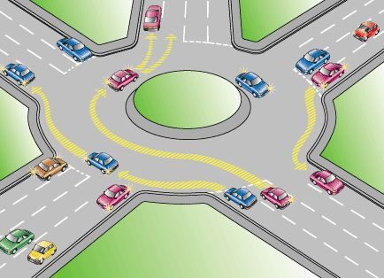
Example 6th. Street Industrial Area Kampala roundabout
Follow the correct lane at roundabouts and give way to traffic coming from your right.
REMEMBER: LONG VEHICLES NEED MORE SPACE TO MANUVOUR

Slide 29
MARKING THE JUNCTION BOX
AT
LARGE ROUNDABOUTS
Bearing in mind that a road-junction is the intersection area where a road or lane joins with another road, lane, roundabout or railway crossing:
Every lane or road joining a roundabout is treated as a separate junction.

Slide 30
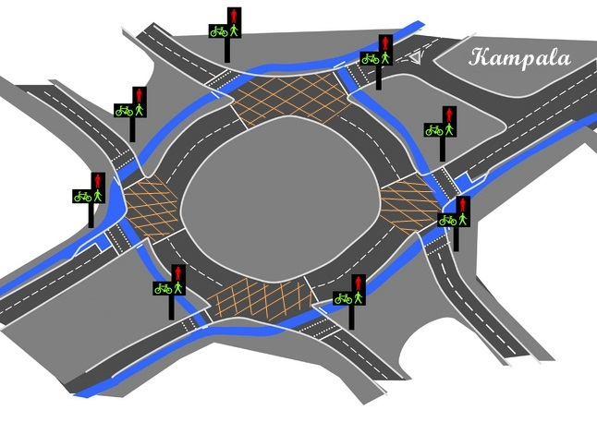
Marking large roundabouts with a junction Box:
Solution to Competitive Driving and traffic congestion at road-junctions

Slide 31
Junction Box at a
Railway Crossing

Slide 32
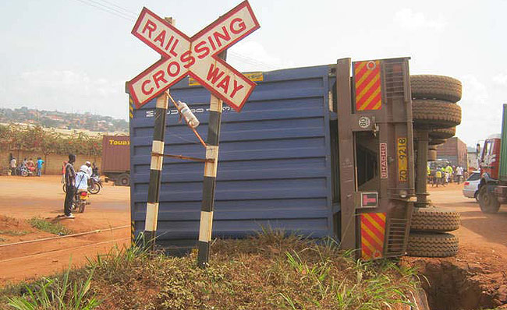
Railway Crossing without a junction Box
Solution to Competitive Driving and traffic congestion at road-junctions

Slide 33
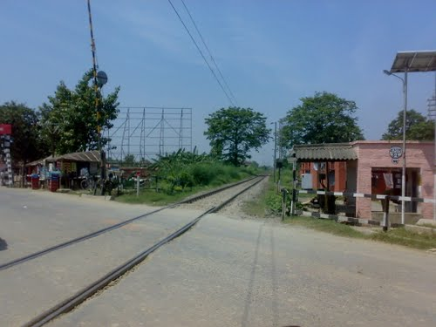
Junction Box at a Railway Crossing
Solution to Competitive Driving and traffic congestion at road-junctions

Slide 34
Tackling
Traffic jam caused by
wrong Parking & Pavement Activities

Slide 35
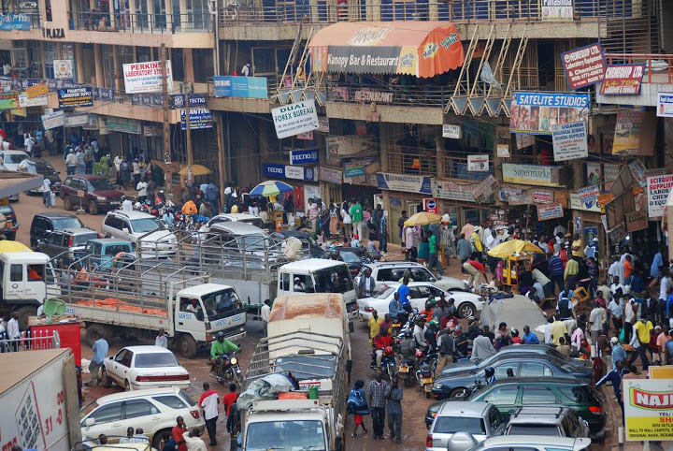
Images of traffic congestion caused by wrong parking and Pavement activities

Slide 36
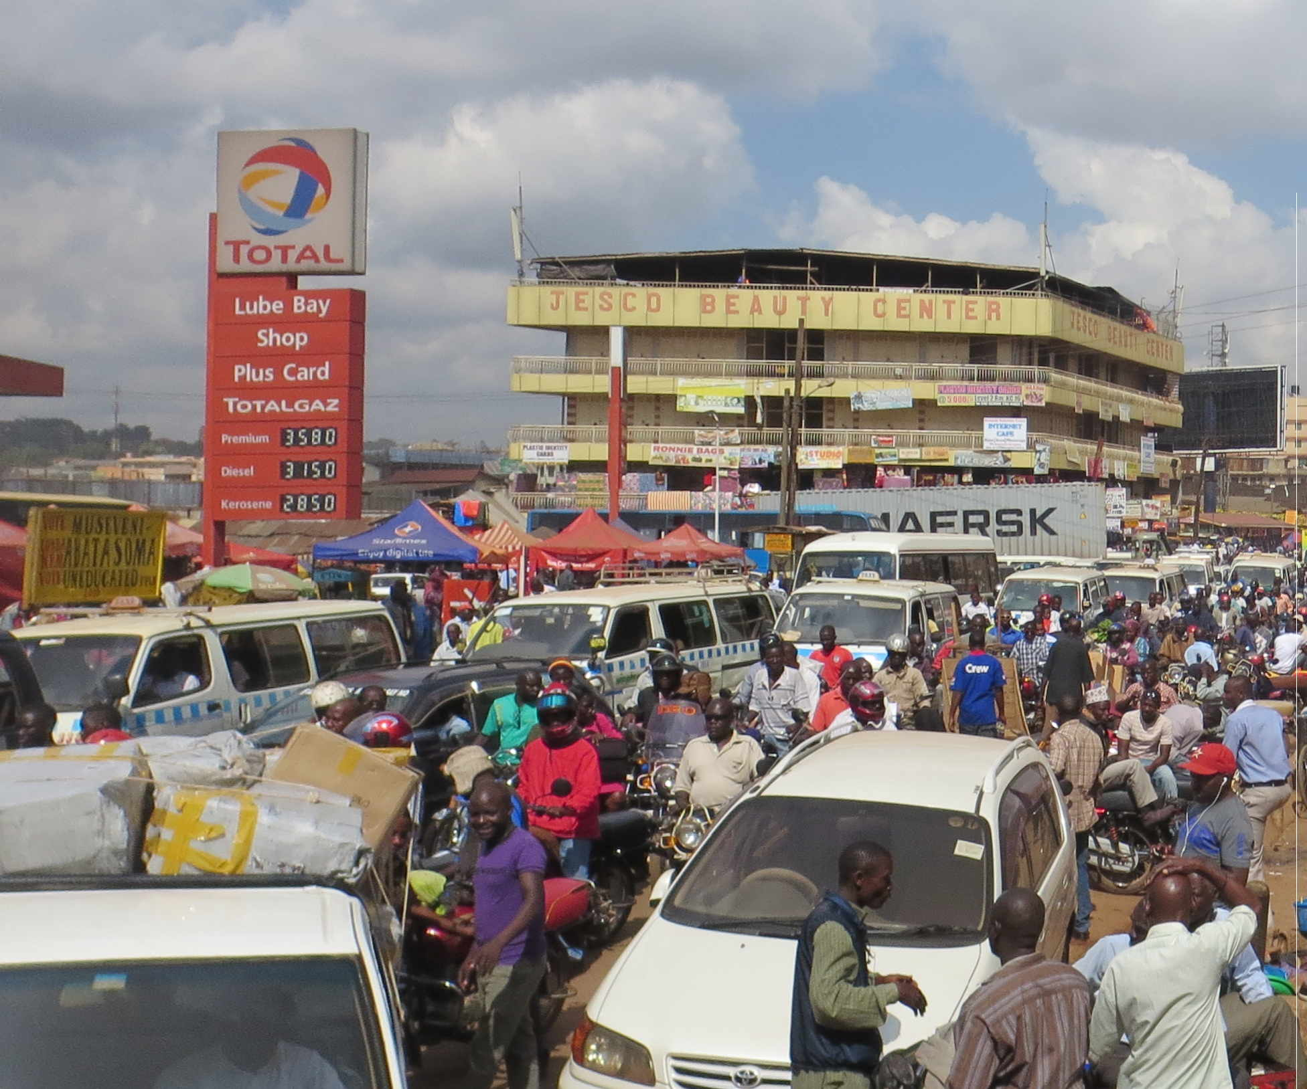
Turning vehicle
Parked at road junction
This gridlock was caused by one vehicle parked at the road junction. This prevented one vehicle from turning thereby building traffic jam to hundreds of traffic to corresponding roads and lanes.
Images of traffic congestion caused by wrong parking and Pavement activities

Slide 37
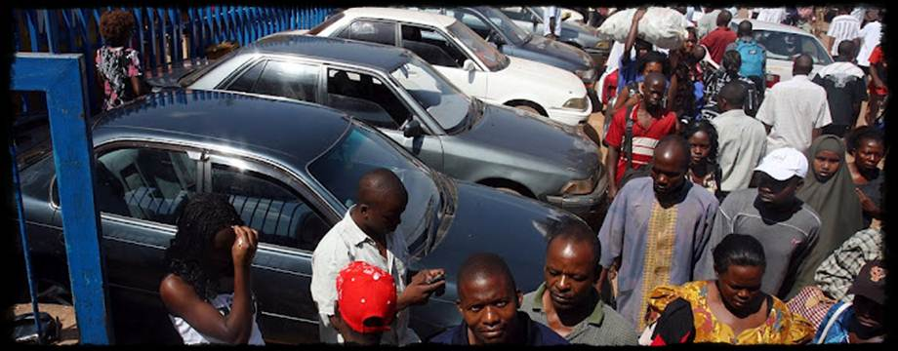
Tackling Traffic jam cause by wrong parking
Vehicle should park along side the kerb NOT cross-ward the road.
The pavement or walk space is turned into parking.
Pedestrian are stuck in the traffic flow.
Images of traffic congestion caused by wrong parking and Pavement activities

Slide 38
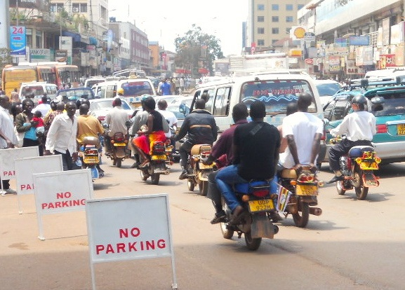
The traditional method Restrictions:
Kerb-side stand-signs
Kerb-side stand-signs: Reduce the road capacity, deny pedestrians a walk space, sends them into the traffic flow, putting their lives at risk, tops-up traffic congestion on roads.
Tackling Traffic jam caused by wrong Parking & Pavement Activities

Slide 39
Morden Method:
On-road surface
Restriction
Markings for
Parking
Tackling Traffic jam caused by wrong Parking & Pavement Activities / Modern Method

Slide 40
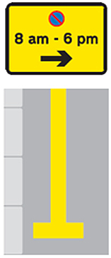

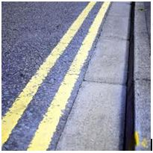

NO WAITING RESTRICTION
ROAD-MARKINGS
Single yellow lines mean:
NO waiting at times given
Double yellow lines mean:
NO waiting at any time
Tackling Traffic jam caused by wrong Parking & Pavement Activities / Modern Method

Slide 41
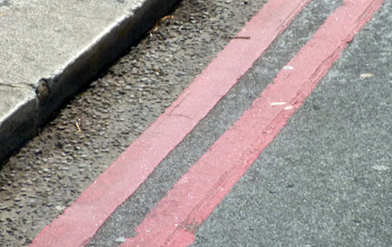
NO STOPPING ROAD-MARKING RESTRICTION
Double Red line mean “Red Route”:
NO Stopping at any time.
e.g. at State House, Bank of Uganda, Embassies, Centenary Bank Kampala rd. etc
Single Red line mean:
NO stopping during times shown
Tackling Traffic jam caused by wrong Parking & Pavement Activities / Modern Method

Slide 42
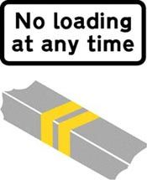
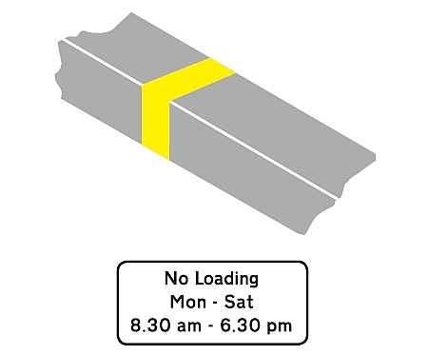
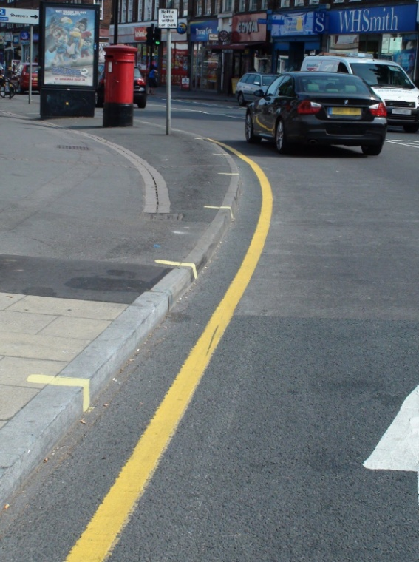
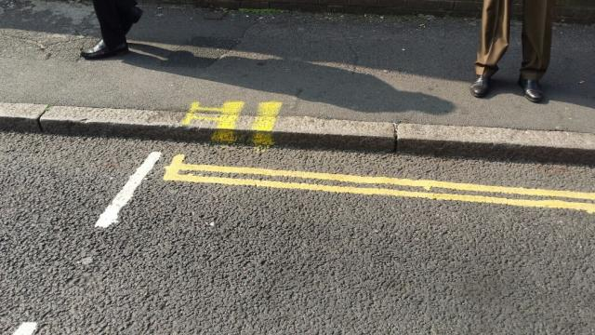
NO LOADING ROAD-MARKING RESTRICTIONS
NO Loading at any time
NO Loading during times shown
e.g. at road junctions, City Square, Main Post office Kla. etc.
Tackling Traffic jam caused by wrong Parking & Pavement Activities / Modern Method

Slide 43
Advantages of the Modern method:
Road-Markings are the modern way of displaying road-restriction messages to traffic. They are painted on the road surface, giving a clearer message than kerbside stand-signs which reduce road-width and capacity.
On road surface restriction markings DO NOT affect or reduce the road capacity;
They indicate exactly where the restriction starts and where it ends;
They indicate the times and days of the restriction.
They give a Driver the chance to concentrate on safety on the road
thereby reducing the risk of accidents (road-crash).
NOTE: Some roads may NOT be tarmacked but we have the solution.
Instead of wasting public funds to “monitor, enforce and or guide traffic” on public roads, Traffic offenders or those that violate rules of the road (Highway code) instead become a REVENUE BASE to the national economy in form of express fines.
This is the principal in developed countries.
This approach encourages drivers to study and observe the HIGHWAY CODE in a bid to avoid the express fines. Consequently the road crash-rate and traffic offences will significantly drop.
The Highway code includes the “on road surface restriction markings”.
NOTE: Every driver is required by law to master the Highway code before getting on road.

Slide 44
Tackling
Traffic jam along streets

Slide 45
Alternating Parking on arterial roads
This approach requires that parking on parallel arterial roads alternate at peak hours of traffic.
This means that during the morning peak hours of traffic thus from 7am to 9:30am, parking, loading off-loading (waiting) is restricted on entry arterial parallel roads and allowed on the corresponding exit parallel arterial roads.
During the evening peak hours of traffic (from 4:30pm to 8pm), parking, loading and off-loading (waiting) is restricted on exit parallel arterial roads and allowed on the corresponding entry arterial parallel roads.

Slide 46
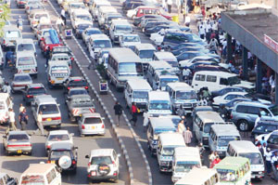
Solution:
Alternating Parking on arterial roads
Allow parking on exit
Restrict Parking on entry peak hours
Parking along busy (arterial) roads at peak hours reduces the road capacity

Slide 47
Maximizing the use
of the
Road-capacity
The Traffic Police and Guides in some cases limit the use of FOUR lane-capacity roads to only TWO at peak hours of traffic; this is under-using roads.
The full capacity of the Road-lanes should be used especially at peak hours of traffic to reduce queues (length of lines).
We do recognise that many roads are not marked but the traffic police has the ability to guide traffic to fully and safely utilise roads.

Slide 48
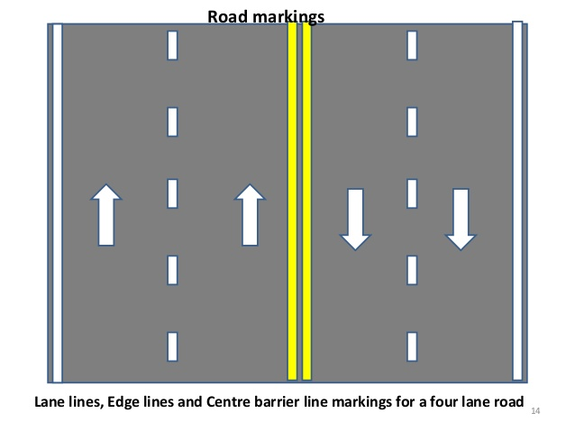
Even when the road is not marked, the traffic police can guide traffic to utilise the full capacity of roads at peak hours
Maximizing the use of Road-capacity

Slide 49
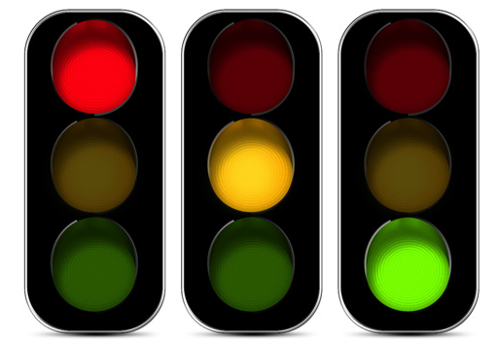
Traffic Lights
TRAFFIC LIGHTS
In Uganda traffic lights operate on timers no matter what time of the day and the volume of traffic from a particular direction.
This has prompted the traffic Police to ignore their normal mode of operation at pick hours of traffic by using hand signals instead.
TRAFFIC DETECTORS:
Detectors sense the length of traffic from a particular direction and control the time the traffic lights take to change.

Slide 50
The Implementation System of the
Restriction-measures

Slide 51
The MESS system
The System to efficiently enforce the Restrictions:
Some motorists only obey the Highway Code because the traffic police can see them or where traffic cameras are fixed.
However both of the above mechanisms can NOT be everywhere all the time and their locations are familiar to violators. In this situation, the violators warn one another of their presence.
We have innovated the MESS (Mobile Electronic Surveillance System). This technology is designed to deter this practice.
The MESS system is a Ugandan unique innovation. It is mobile, unpredictable, convenient, cheaper and more effective whether it is raining, shining, day or night.
The MESS system does not require the traditional method of man power but uses GPS (Global Positioning System).
The revenue generated from violators sustains the system without resorting to public funds. Contact us for details!
The Implementation System of the Restrictions

Slide 52
Closing remarks
Traffic Congestion is an alarming public out cry affecting the movement of traffic, goods and services.
The initiatives presented have successfully worked in many countries especially Great Britain of which Uganda was a Colony.
The planning authority can play an important role in ensuring that these initiatives are carefully considered to form part of the long-term planning for Kampala road-network.
Please do not hesitate to contact us should you need more information.
Muteza Ali
CEO/RSI (U)

Slide 53
Live images of the
Restrictions in other Countries

Slide 54
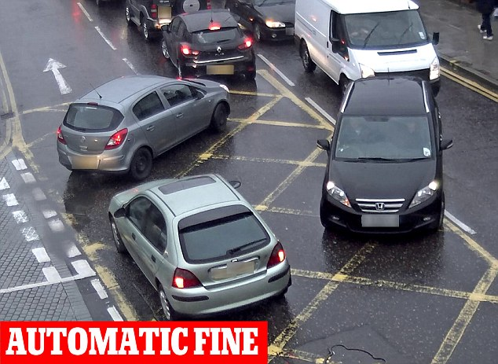
Live images of the Restrictions in other Countries

Slide 55
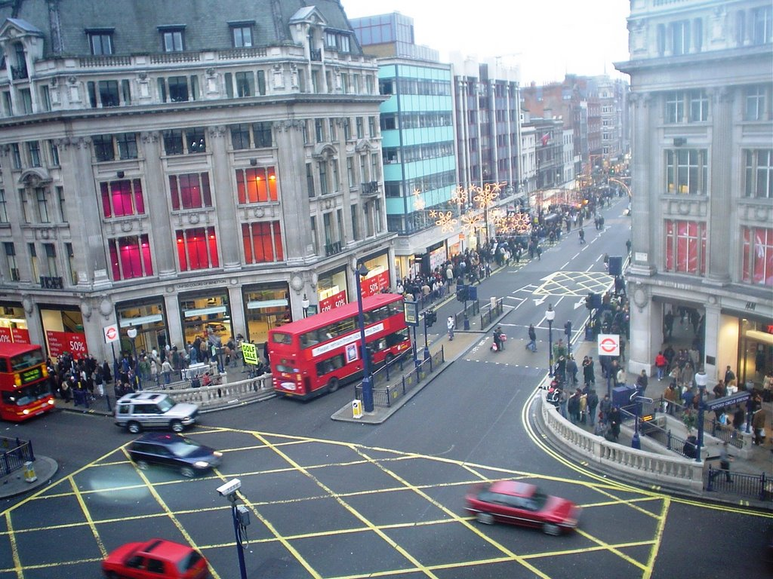
CAMERA
Live images of the Restrictions in other Countries

Slide 56
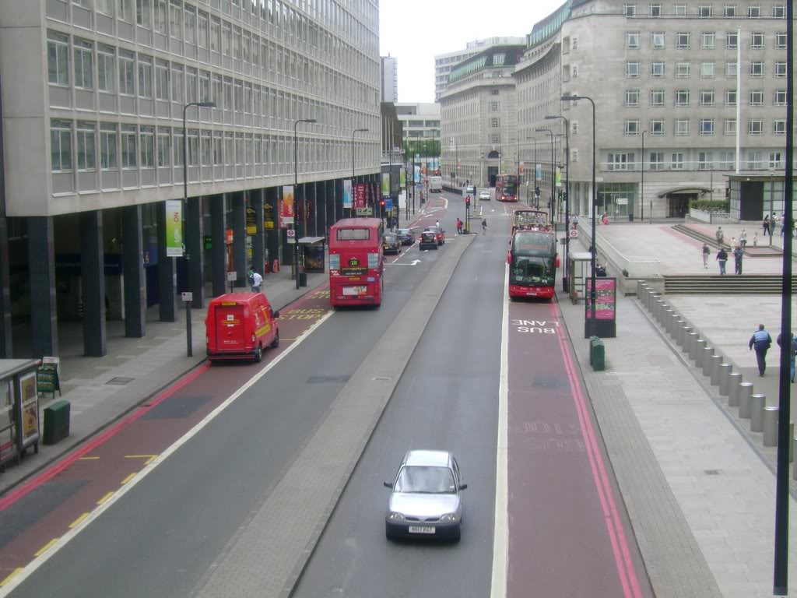
Stop for taxi & delivery vans
Live images of the Restrictions in other Countries

Slide 57
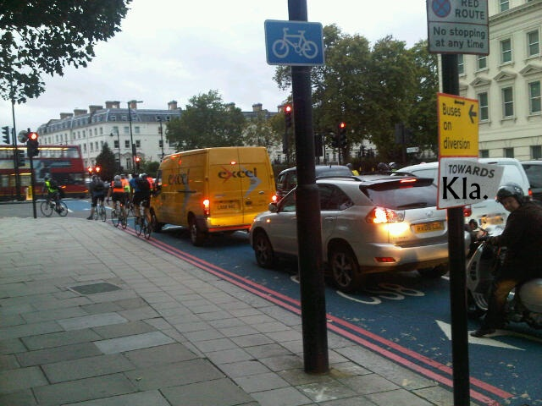
Live images of the Restrictions in other Countries

Slide 58
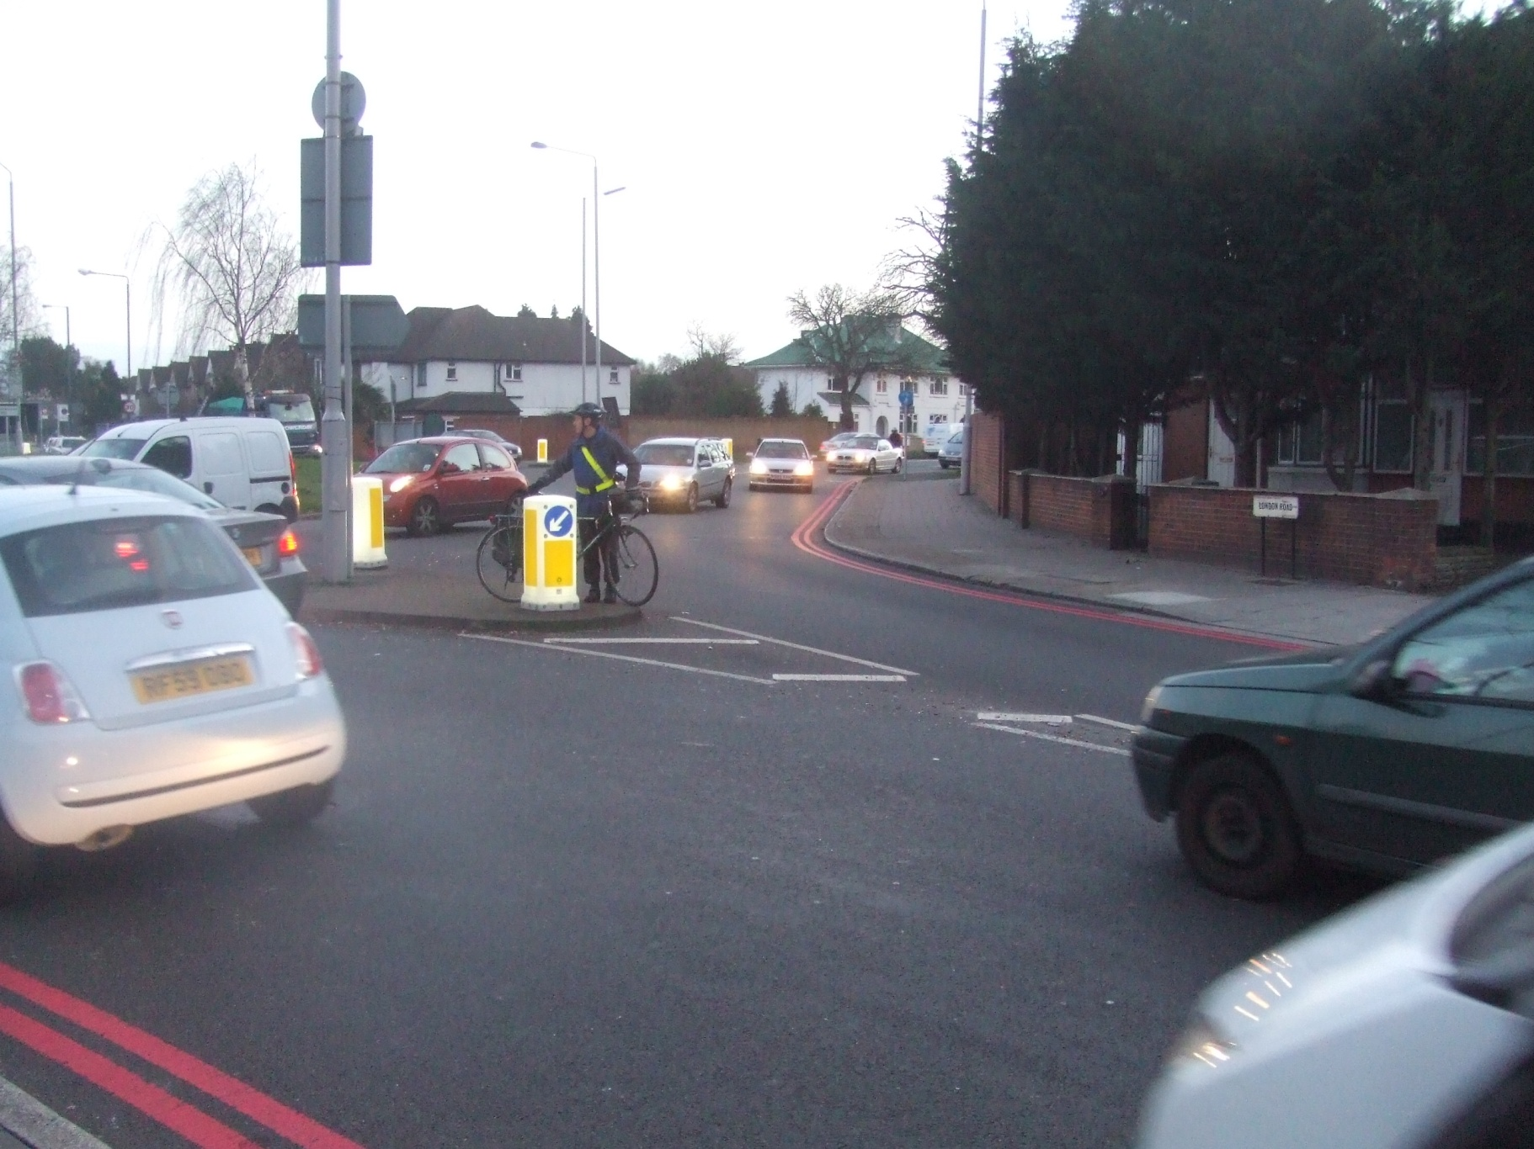
Live images of the Restrictions in other Countries

Slide 59
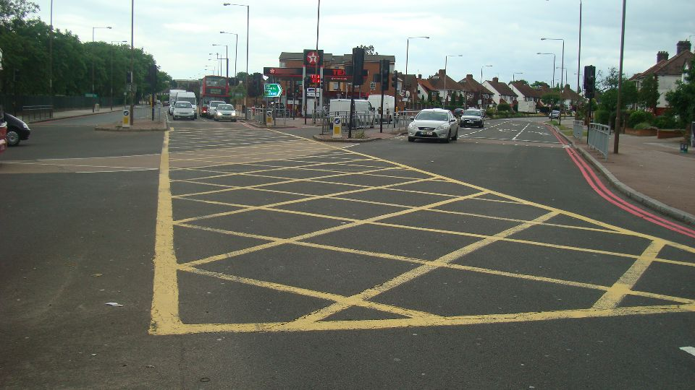
Keep Clear
NO Stopping at any time
Live images of the Restrictions in other Countries

Slide 60
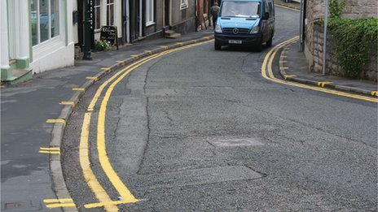
Live images of the Restrictions in other Countries

Slide 61
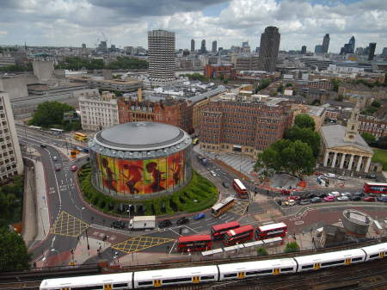
Live images of the Restrictions in other Countries

Slide 62
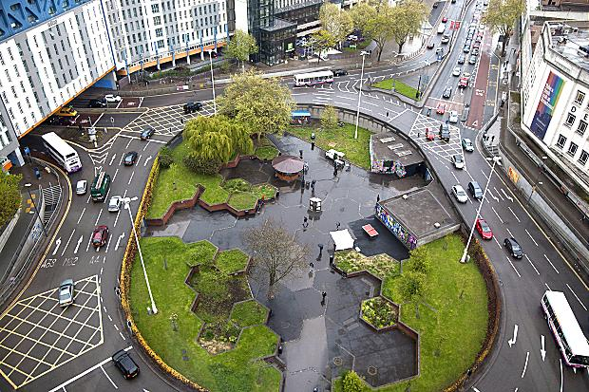
Live images of the Restrictions in other Countries

Slide 63
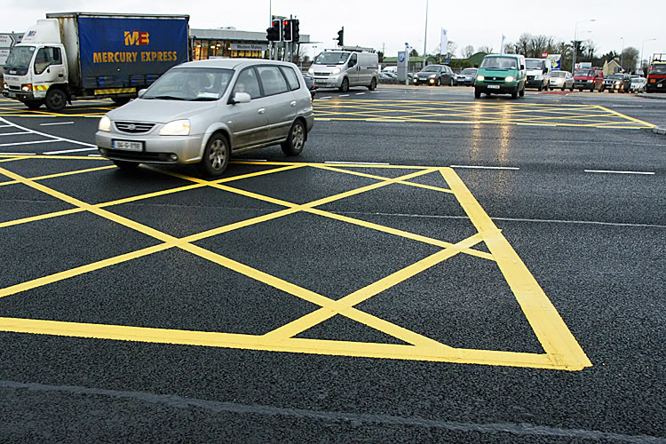
End
The junction Box is marked regardless of Traffic lights in place
Live images of the Restrictions in other Countries

